Slide 1



Technical Facilities of Infrimation
Prepared & Presented by: Mirlan Nurbekov, Lecturer
Office hours: Friday 9:00–17:00
AlaToo IT & Business College
Fall 2025

Slide 2
A001
Instructor Reference Solution
IT infrastructure and security design for MirlanO Retail
Instructor solution presented by: Mirlan Nurbekov
Objective: Design, justify, and present a complete, secure, and scalable IT system for a retail business with warehouse operations.

Slide 3
Business and operational overview
Two facilities:
Main Store – 50×50 m (customers, cashiers, managers, CCTV)
Warehouse – 25×25 m (loaders, inventory, CCTV)
Personnel (22 total, rotating shifts):
2 Managers (administration, remote access)
10 Consultants/Cashiers (2 active tills)
8 Loaders (warehouse operations)
2 Security Guards (monitor CCTV and store floor)
Goal: Ensure smooth sales operations, real-time stock tracking, and secure monitoring.

Slide 4
Key design objectives
Build a secure, reliable, and scalable network
Enable real-time data access
(POS ↔ inventory ↔ database)
Provide CCTV coverage with 14-day retention
Support remote management via secure VPN
Stay within budget: 850,000 KGS

Slide 5
System architecture philosophy
We adopt a hybrid on-premises architecture:
Core business data (POS, inventory, ERP) stored locally for speed and control.
Cloud backup ensures disaster recovery and off-site redundancy.
Separate network layers (VLANs) for security isolation.
Modular components ensure easy scalability without re-architecture.
Why this approach?
Because small businesses need fast local access (for cashiers) but also resilience if local hardware fails — hybrid architecture provides both.

Slide 6
Logical network design
Layer | Function | Components
Edge | Internet access, firewall, VPN | TP-Link ER605
Distribution | Switching, VLANs | TP-Link TL-SG1024
Access | Endpoints, cameras, Wi-Fi | PCs, POS, CCTV, APs
Data | Storage, servers | Dell PowerEdge + Synology NAS
Security | IDS, firewall rules, encryption | Router ACLs, AES encryption

Slide 7
Why layered?
I chose to make it layered to isolate faults, simplify troubleshooting, and protect critical assets. Each layer serves a single purpose — this is how enterprise networks are built.

Slide 8
VLAN Segmentation Rationale
VLAN | Purpose | Subnet | Access rules
10 | Admin/Managers | 10.10.10.0/24 | Full access
20 | POS/Consultants | 10.10.20.0/24 | DB access only
30 | CCTV | 10.10.30.0/24 | Isolated, outbound blocked
40 | Warehouse | 10.10.40.0/24 | ERP, limited Internet
99 | Management | 10.10.99.0/24 | Network devices only

Slide 9
Why VLANs?
To enforce principle of least privilege — if a cashier PC is infected, it can’t reach cameras or servers directly.

Slide 10
Physical layout overview
Objective is to ensures full coverage, minimizes blind spots, and guarantees signal stability.
Main Store:
2 cameras at entrances
2 above cashiers
2 aisle cameras
2 Wi-Fi APs (front & back)
Manager’s office with rack cabinet (server + NAS + UPS)
Warehouse:
4 CCTV cameras (corners + door)
1 ceiling AP for handheld scanners
CAT6 cable trunk line to store cabinet

Slide 11
Hardware selection and justification
Category | Model | Reason
Server | Dell PowerEdge T40 (Xeon E-2224G, 16GB RAM, 2TB HDD) | Enterprise reliability, expandable RAM/storage, ECC memory
NAS | Synology DS220+ (2×8TB WD Red) | RAID1 redundancy, Active Backup, supports CCTV
Router | TP-Link ER605 | VPN, VLAN, firewall, Omada control
Switch | TP-Link TL-SG1024 | 24 Gigabit ports, headroom for scaling

Slide 12
Hardware selection and justification
Total: ~662,000 KGS
Remaining: 188,000 KGS (for software + services)
Category | Model | Reason
APs | TP-Link EAP225 | High user capacity, cloud management
CCTV | HikVision DS-2CD2043G2-I | Local warranty, 4MP resolution, night vision
PCs & POS | Lenovo ThinkCentre + Sunmi POS | Durable, local warranty, compatible with ERP
UPS | APC 1100VA | 30+ minutes uptime for core system

Slide 13
Software stack
Category | Software | Notes
OS | Windows server 2022 | Secure domain control
Database | MySQL | For ERP + web data
Backup | Acronis / Synology active backup | Daily scheduled
Monitoring | PRTG Network Monitor | Performance + logs
ERP / CRM | Odoo (Open Source) | Manage sales, HR, inventory
Web platform | WordPress + WooCommerce | Fast deployment for store

Slide 14
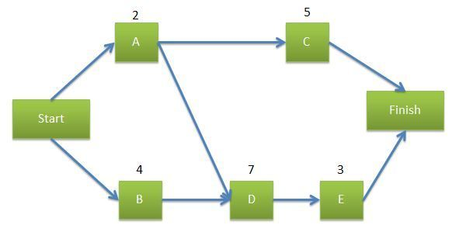
Network diagram
Internet cloud → Router (Firewall) → Switch → Server → PCs
Wi-Fi Access Point connected to Router NAS connected to Server for backups

Slide 15
Backup and security plan
Primary backup: NAS (RAID 1 mirror)
Secondary: weekly encrypted cloud backup (Google Drive or AWS S3)
Firewall: TP-Link ER605 (with rules for internal/external access)
Encryption: AES-256 file encryption for sensitive data
Authentication: multi-factor login for admin accounts

Slide 16
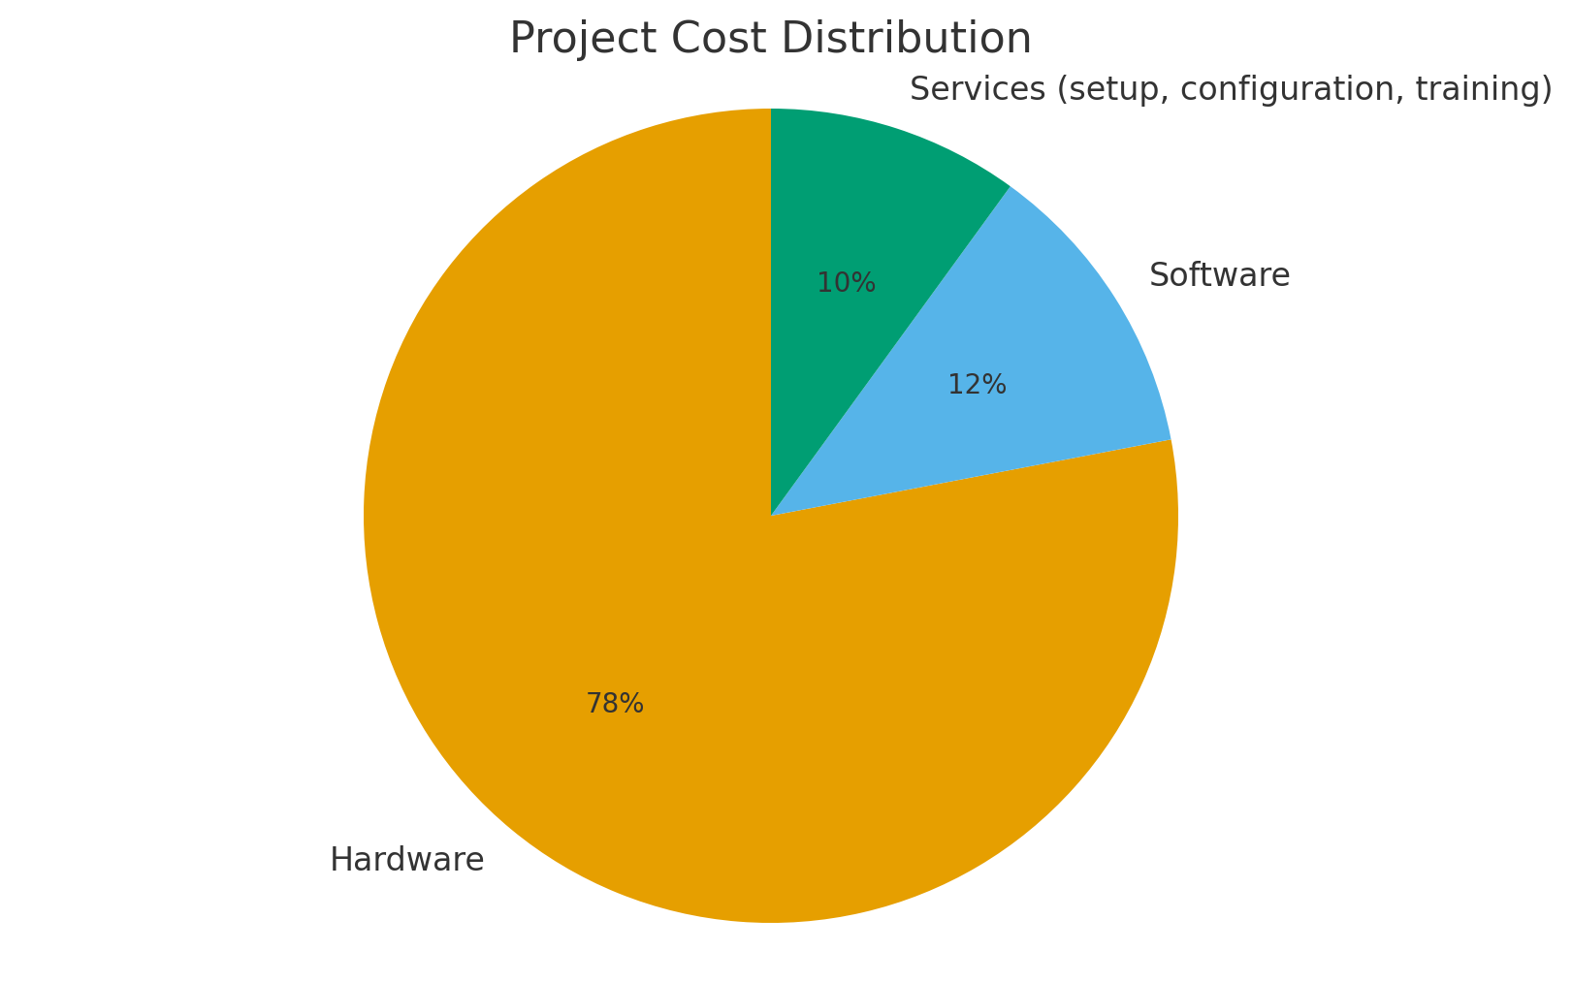
Cost breakdown summary
Total: ~662,000 KGS
Hardware – 78%
Software – 12%
Services (setup, configuration, training) – 10%

Slide 17
Delivery and setup timeline
Week | Task | Description
1 | Procurement | Order hardware/software
2 | Installation | Setup network, servers, PCs
3 | Configuration | Software install + testing
4 | Handover | Documentation + staff training

Slide 18
Scalability plan
Add 2nd branch by expanding LAN → VPN site-to-site connection
Add cloud server for load balancing e-commerce
Increase NAS capacity (4TB+) as sales grow
Upgrade switch to PoE for advanced CCTV

Slide 19
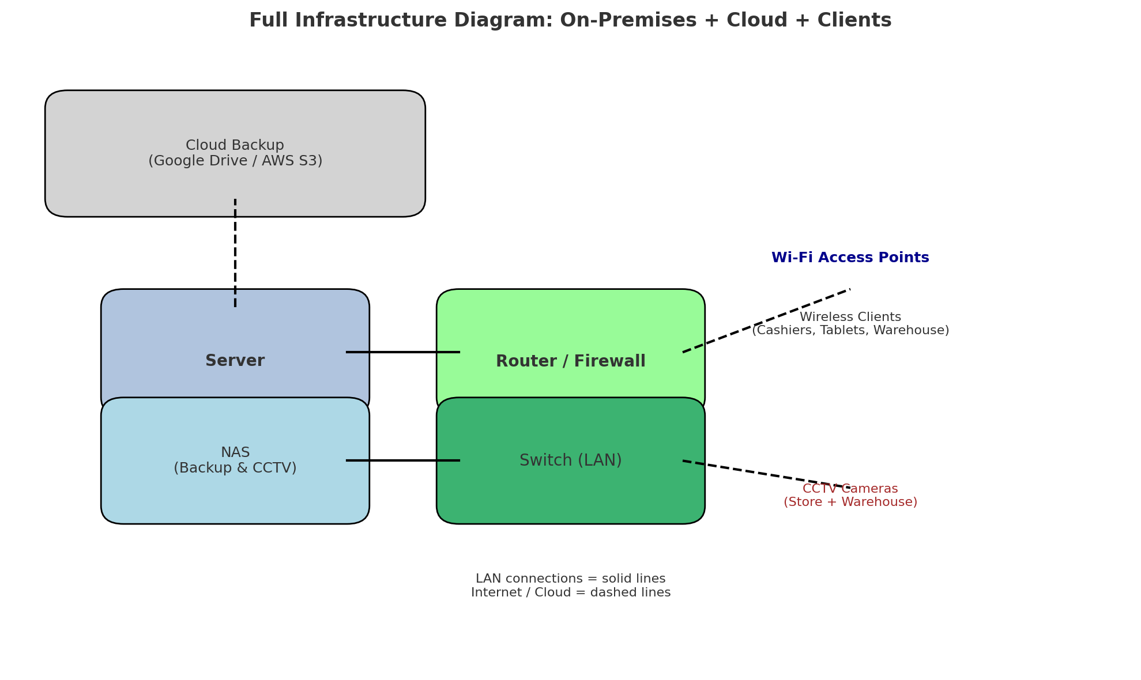
Full infrastructure
On-prem servers + cloud backup + Wi-Fi + CCTV + client endpoints

